Slide 1
PROBLEM SOLVING 101
An Introduction To Project Management
Mike Mitchell
Mike Mitchell Consulting LLC
Mike@mikemitchell.consulting
774-261-0571

Slide 2
Project Management
Historically, Projects were large, complex undertakings. This is still how many people think of Projects.
Actually, you can implement various Project Management strategies and techniques to complete tasks of all types and sizes, timely and properly.
Projects have become the way that organizations accomplish work…

Slide 3
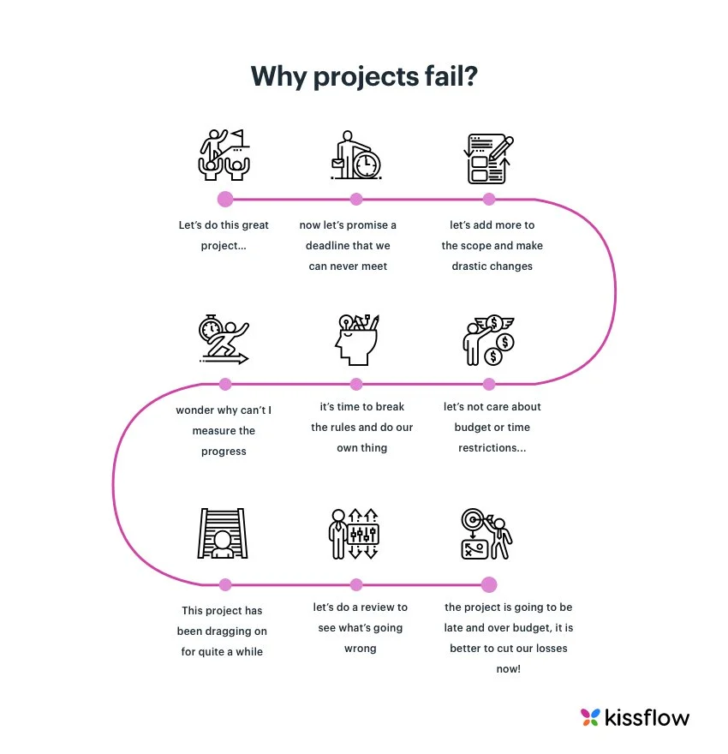
…however, not all organizations are very good at managing projects

Slide 4
What is a Project?
Projects versus Processes
Projects
Temporary, one-time endeavor that addresses specific opportunities or problems
A clear set of operations designed and intended to create change
Explicit desired result
Established timeframe that the work will take place and be completed
Required resources
List of detailed activities required to be completed
Processes
Established procedures for ongoing work designed to resist change
They establish a workflow that should always be followed
Intended to create value by repeatedly performing a series of tasks

Slide 5
Why use a Qualified and Experienced Project Manager?
A project manager is a problem-solver. Professionals who organizes, plans, and executes projects. Project managers lead the teams, assist in defining the goals, communicate with the stakeholders, and leads projects through to completion
Strategic business partner
Encourages and recognizes the contributions of others
Respects and motivates stakeholders
Stresses integrity and accountability
Fully vested in the success of the project
Able to “work in the gray”
Allows for business leaders to stay focused on running the business

Slide 6
Who is Mike Mitchell Consulting?
I have 30 years of experience managing projects at companies large and small
I bring a pragmatic approach to project management that is structured and repeatable
Using proven project management tools and best practices, I manage all phases of the project lifecycle to ensure project outcomes meet or exceed project objectives
Leveraging my strengths as an effective communicator, problem solver, and relationship manager, I minimize the impact on the organization of the project management process

Slide 7
What are some tools/best practices used?
Clearly Defined Objectives
Team must be aligned on project goals
Scope Management
Objectives and deliverables should not change as work progresses
Realistic Expectations
What does Success look like and how will it be measured
Appropriate Resources
Budget, Staff, Time, Subject-Matter Expertise, etc.
Communication Plan
Clear and Concise Communications to all Stakeholders
Scheduling
A Detailed project plan with specific tasks, owners, and due dates

Slide 8
What are some tools/best practices used?
Business Case
Defines the general business goals and justifications for a project
Statement of business problem or opportunity the proposed project addresses
Reason action is needed or ramifications if action is not taken
Expected Benefits
Estimated Timeline
Estimated Costs
Business Options
Proposed course of action

Slide 9
What are some of tools/best practices used?
Project Charter
Officially sanctions the start of a project
Outlines the specific goals, objectives, and resources for the project
Project Description
Project Objective
Project Team – Project Sponsor/Business Owner, Project Manager, Subject Matter Experts, etc.
Stakeholders
Detailed Scope – What is in and What is out
Deliverables
Timeline including Milestones
Known RAIDs (Risks, Assumptions, Issues, Dependencies)
Requires approval of all Major Stakeholders before project proceeds

Slide 10
What are some of tools/best practices used?
Functional Requirements Document
The objectives or “requirements” for a new project, program, or business solution
Describes the functions that the solution under development must perform in order to meet the project objectives
Requirement Name
Requirement Description
Business need being addressed
Priority - High/Medium/Low
High – Absolutely must have. Showstopper if not available
Medium – Should have but project can move forward if functionality is committed for a later date and/or an acceptable work-around is available
Low – Nice to have if available and practical but not essentially required for the solution to be viable
Disposition – How will the proposed design address the requirement
Status – Yes/No/TBD

Slide 11
What are some of tools/best practices used?
Project Plan - A simple, actionable, and detailed guide covering project execution
What are the specific steps to be completed?
What will these steps accomplish?
For each deliverable on the plan
Who is the owner?
What is the specific activity required?
What is the due date?
What is the current status?
Who owns the plan?
Project Manager
Who will ultimately be impacted by the changes?
Stakeholders

Slide 12
What are some of tools/best practices used?
RACI
Assigns roles and varying levels of responsibilities to team members and stakeholders of a project
Can be used along with or in place of a Stakeholder Register
Ensures that all deliverables are allocated for, and accountability is properly noted
Foundation of a Project Communications Plan
Responsible
Who is responsible for doing the actual work for the project task
Accountable
Who is accountable for the success of the task and is the decision-maker
Consulted
Who needs to be consulted for details and additional info on requirements - the subject matter experts
Informed
Who needs to be kept informed of major updates

Slide 13
THANK YOU!
Mike Mitchell
Mike Mitchell Consulting LLC
Mike@mikemitchell.consulting
774-261-0571

